Slide 1
Physics Skills
Tim Freegarde

Slide 2
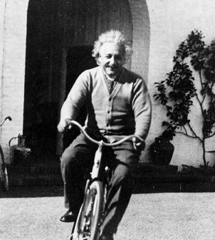
Physics skills
BECOME A BETTER PHYSICIST…
GRADUATE WITH A BETTER DEGREE CLASS…
GENERAL AIMS:
identify physics in a physical situation
apply physical laws, logical deduction and mathematics
analyse qualitatively and quantitatively
compare theory with experiment, or predict what happens next

Slide 3
Physics skills
IDENTIFY PHYSICS IN A PHYSICAL SITUATION…
parse the question
QUESTION TERMINOLOGY
draw a diagram representing the information provided
State, What, Identify, Express, Find
no derivation required
Explain, Describe, How
in words…
Derive, Prove, Show that, Determine
state assumptions, proceed logically
Evaluate, Indicate, Calculate, Estimate
numbers, with clear assumptions
Sketch
as it says…

Slide 4
Physics skills
APPLY PHYSICAL LAWS, LOGICAL DEDUCTION & MATHEMATICS
STRUCTURE OF A DERIVATION
diagram
establishes problem, defines parameters, visualizes question
fundamental principles
physical laws and general assumptions
particular assumptions
approximations, values, regime limitations
mathematics
tautologies which introduce no new physical information but

Slide 5
Physics skills
APPLY PHYSICAL LAWS, LOGICAL DEDUCTION & MATHEMATICS
STRUCTURE OF A DERIVATION
diagram
establishes problem, defines parameters, visualizes question
fundamental principles
physical laws and general assumptions
particular assumptions
approximations, values, regime limitations
mathematics
tautologies which introduce no new physical information but
DERIVATIONS SHOULD BE
logical
rigorous

Slide 6
Physics skills
ANALYSE QUALITATIVELY AND QUANTITATIVELY
APPLY and USE CONSISTENTLY:
vectors
symbols/variables
definite integrals (especially >1D)
differentiation (especially products, powers, functions of functions)
SKETCH or PLOT GRAPHS
label axes
show asymptotes/trends
plot specific values
label important features

Slide 7
Physics skills
COMPARE THEORY WITH EXPERIMENT or PREDICT WHAT HAPPENS NEXT
NUMERICAL VALUES AND INTERPRETATION
units
precision, uncertainty
COMMENTARY
required to explain logic, assumptions, interpretation, conclusions
clarity and accuracy of language essential
http://phyweb.phys.soton.ac.uk/quantum/writing.php

Slide 8
Physics skills
Theophilus p wildebeeste
29081958
COURSEWORK RECORD CARD
feedback and progress
✓
✗
Make sure to include and label all information from question.
✓
✓
JW
attach to every set of coursework
✓
✗
Consider errors and give values to appropriate precision
✓
✓
✓
✓
TS
✓
Diagram excellent!
+
✓
✓
✓
BB
RESOURCES
advice in lab manuals
examples in every textbook
www.southampton.ac.uk/~evans/PHYS-Skills/

